Slide 1

RUMYPET(R U my pet?)
Final Demonstration
Team Groza
Kim Tae Hong (20132335)
Kim Chan Il (20150577)
Paeng Jin Wook (20154645)

Slide 2
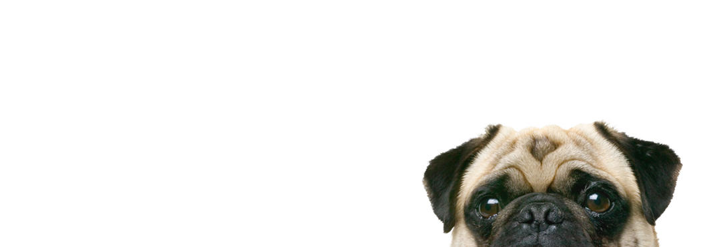
Contents
Introduction
Project Construction
Development Progress
Execution Result
Problem & Future

Slide 3
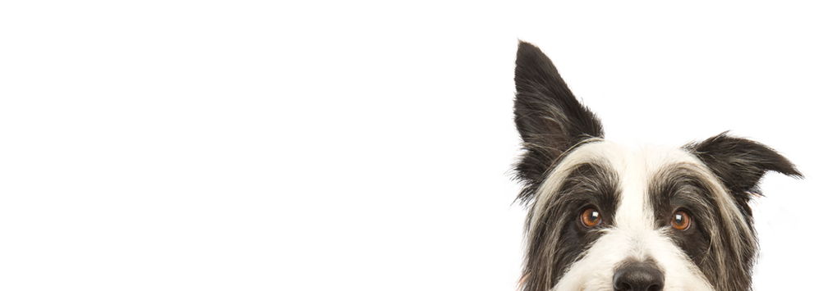
1. INTRODUCTION

Slide 4
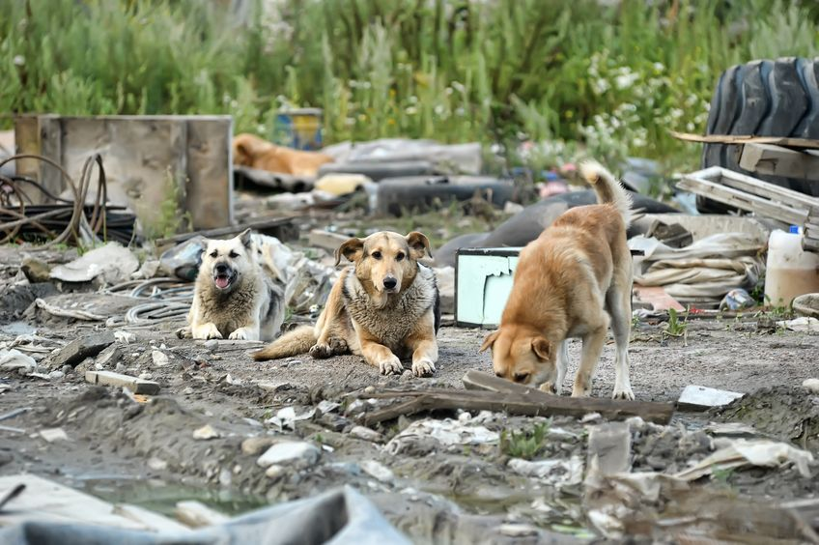
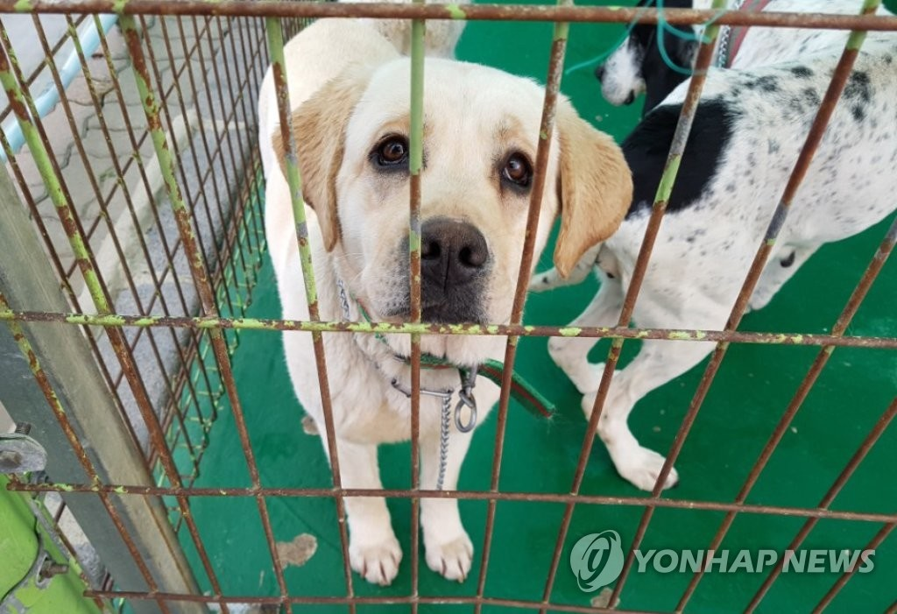
According to the statistics of ‘Animal and Plant Quarantine Agency’,
245 pet animals were abandoned on a daily basis in South Korea.
In Total, about 90,000 animals are abandoned or went missing last year.
And only 15.2 percent of the stray animals were able to return to their owner
Please find my Owner
:(
4
Notes:
Or we can apply it to many other parts.

Slide 5
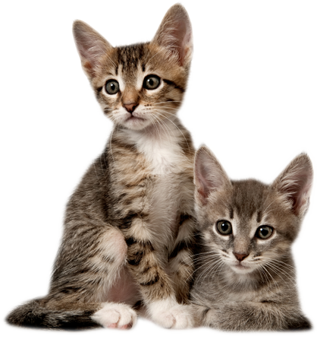
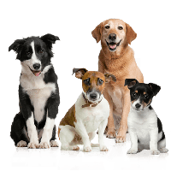
In Animal type, Dogs account for 70.9% of all abandoned pet
4
Notes:
Or we can apply it to many other parts.

Slide 6
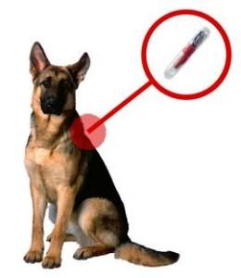
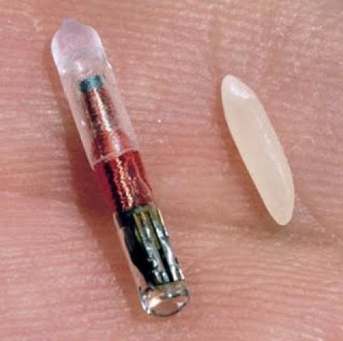
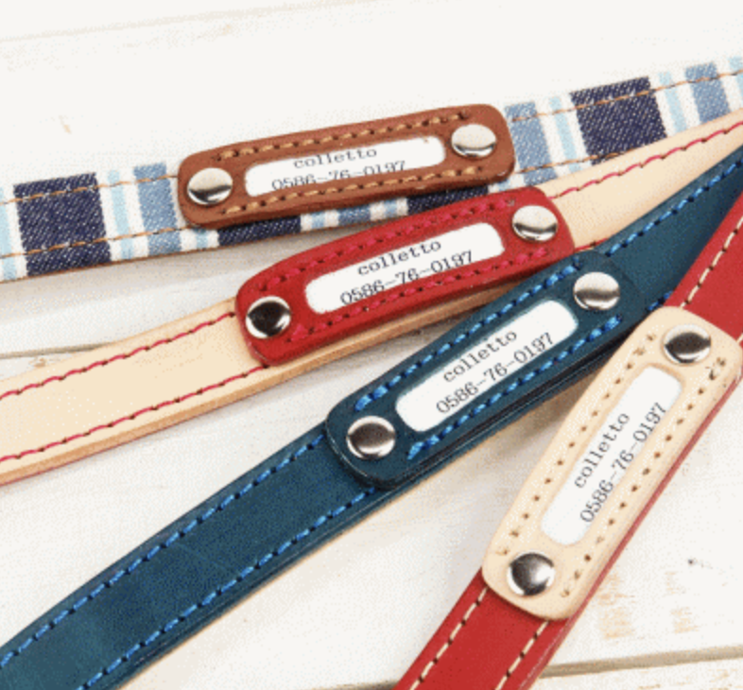
These days, some of the Vet
recommend to implant the Micro Chip in the pet’s body,
But most of the owner don’t want their pet to be implanted.
And the Dog Necklace can be disappear easily,
and some dogs may don’t like it
4
Notes:
Or we can apply it to many other parts.

Slide 7
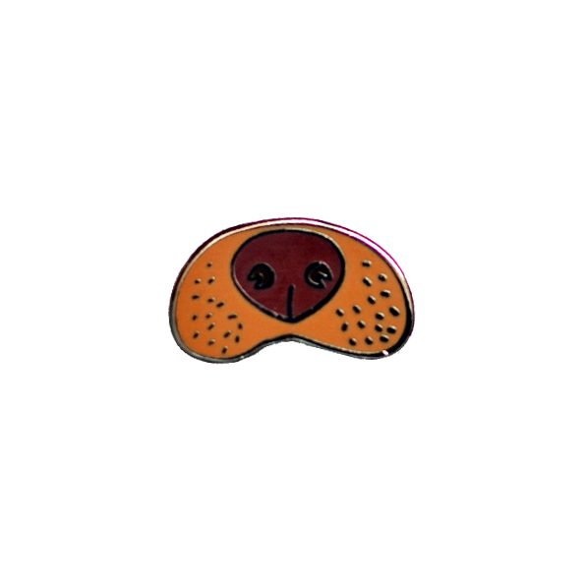

Then we found out that
Dog’s Nose shape is different for each dogs
Same Principle with fingerprint in human side.
4
Notes:
Or we can apply it to many other parts.

Slide 8
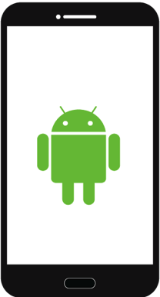
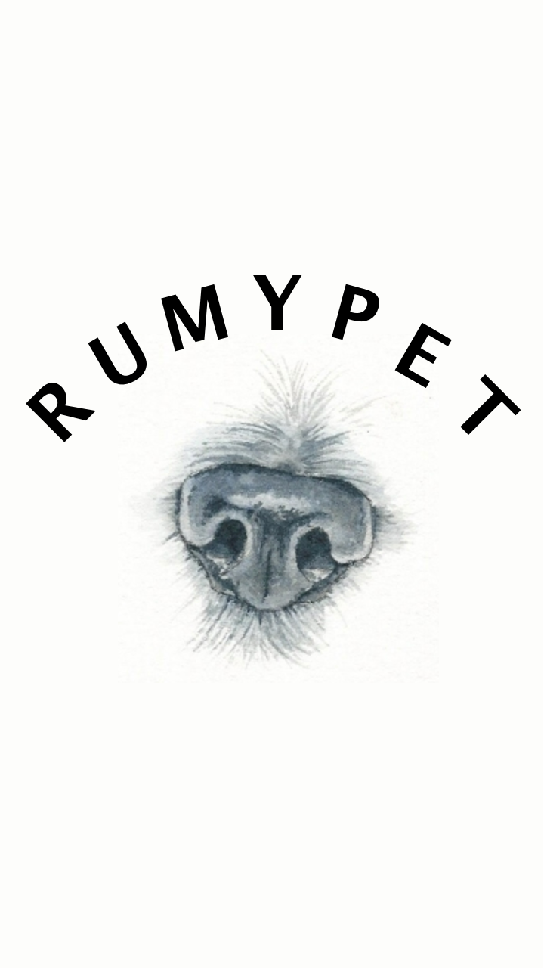

RUMYPET (Are you my pet?)
RUMYPET is a Mobile Application (Android)
that can register Identification of the dog
by taking a picture of their nose.
4
Notes:
Or we can apply it to many other parts.

Slide 9
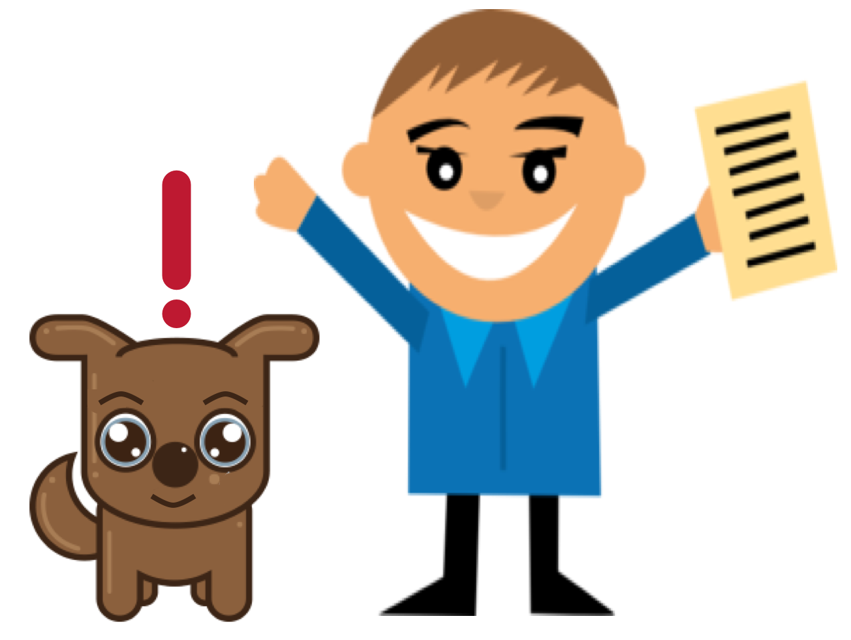

Using this Application, we can find the lost dog’s owner.
And maybe it can be used in many ways related to the dog’s identification
4
Notes:
Or we can apply it to many other parts.

Slide 10
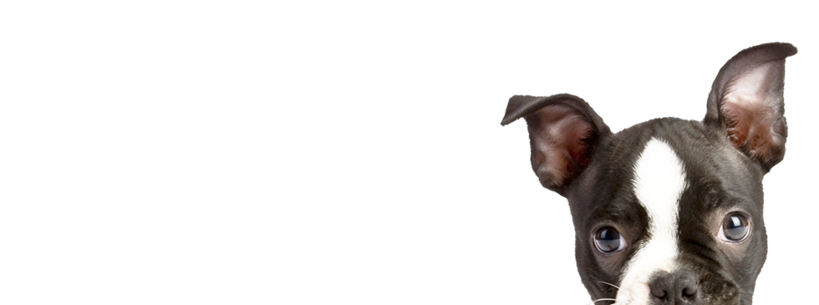
2. Project Construction

Slide 11
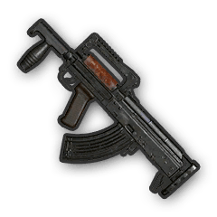
We are team Groza
5

Slide 12

Our team is consist of three people
5

Slide 13
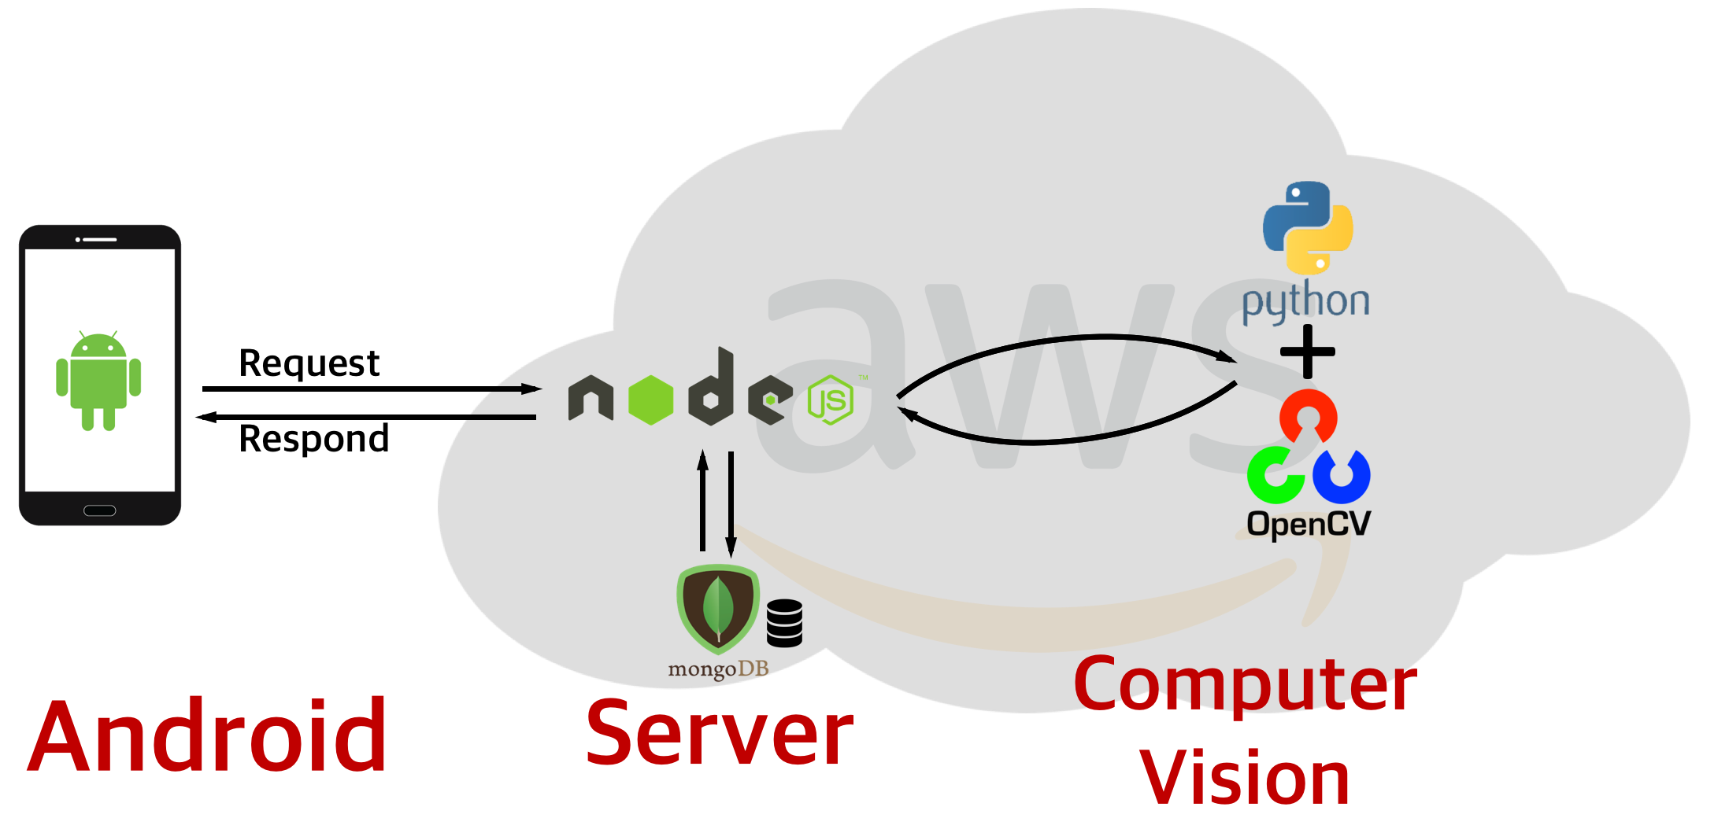
So we divide our job into 3 Parts
5

Slide 14

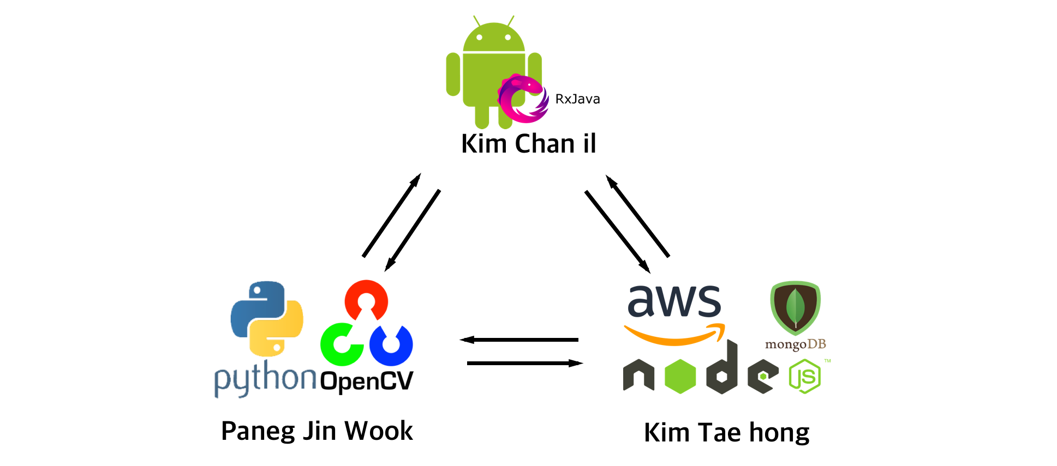
https://github.com/GrozaTeam/Rumypet
5

Slide 15
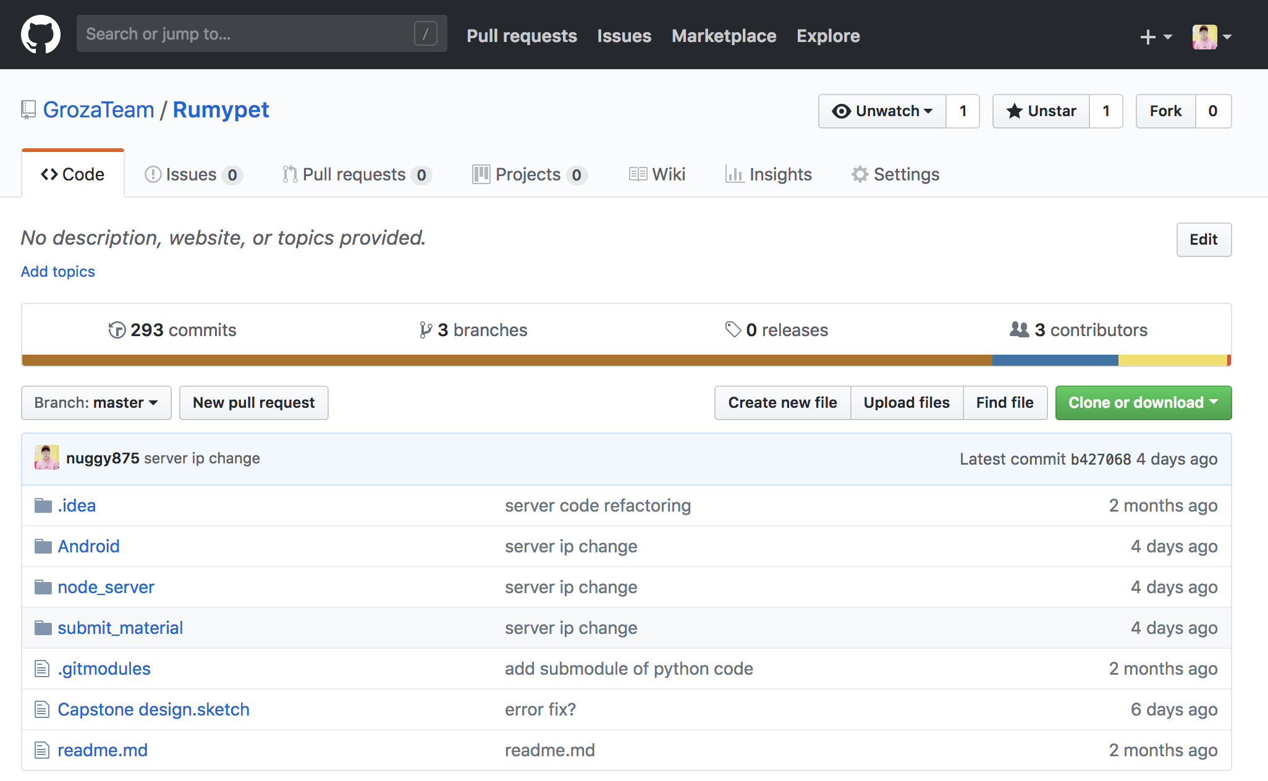
https://github.com/GrozaTeam/Rumypet
5

Slide 16
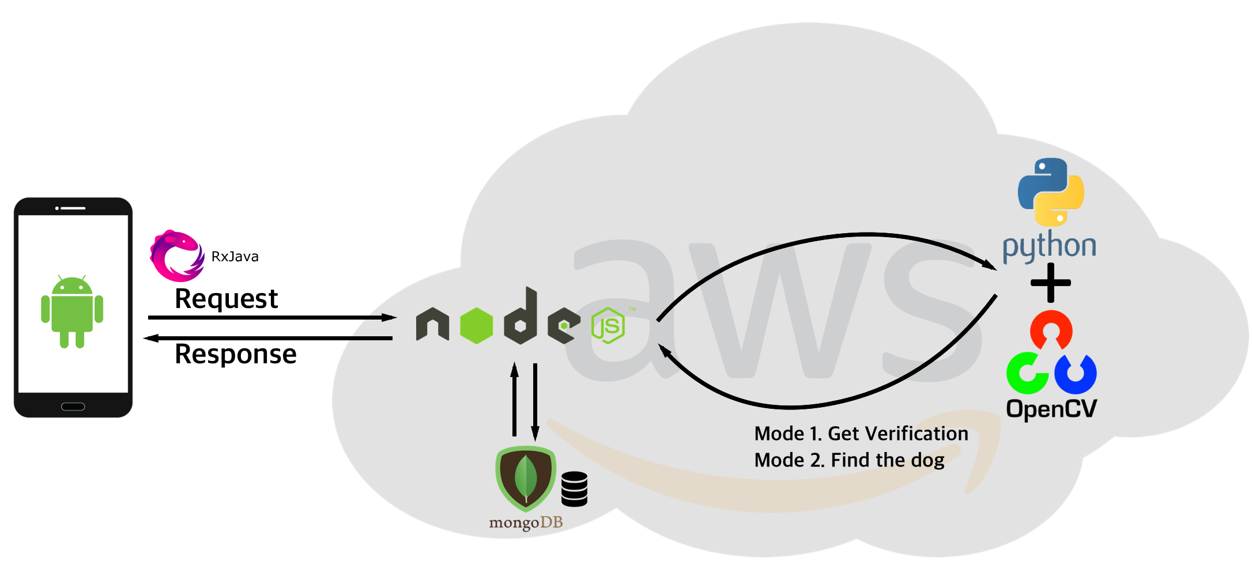
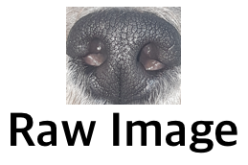
Project Flow Mode 0 : Registration
“Complete”
4
Notes:
This is the schedule later.

Slide 17
Project Flow Mode 1 : Verification
“True”
4
Notes:
This is the schedule later.

Slide 18
Project Flow Mode 2 : Identification
“Dog 2”
4
Notes:
This is the schedule later.

Slide 19
3. Development History

Slide 20
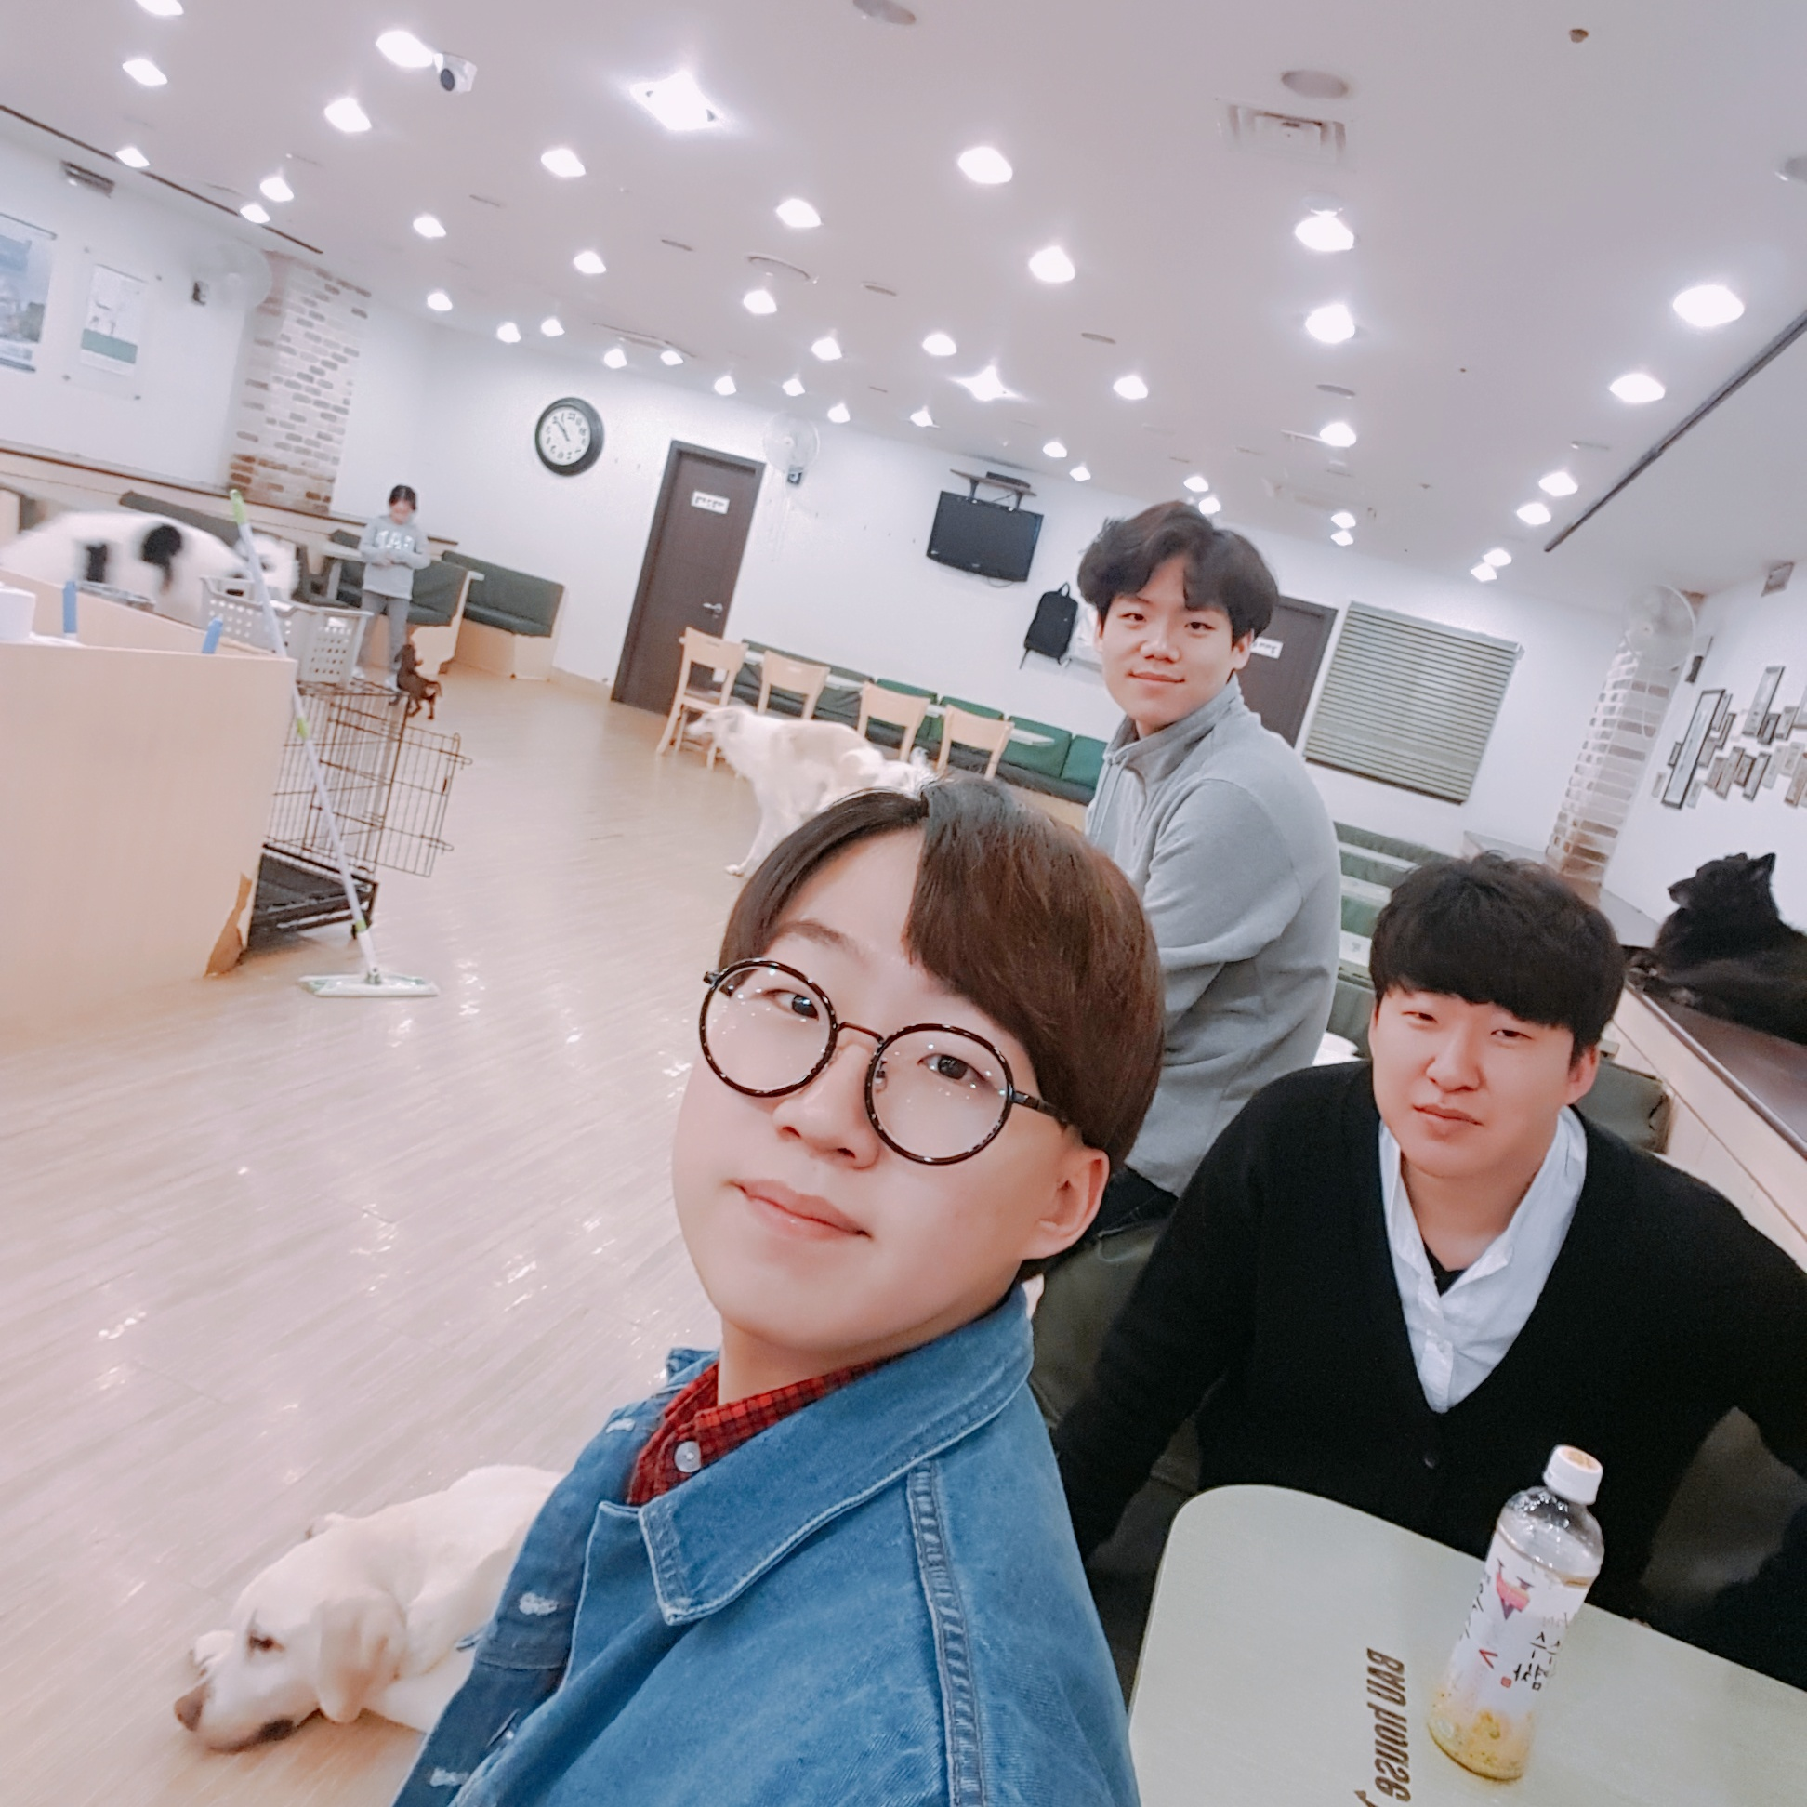
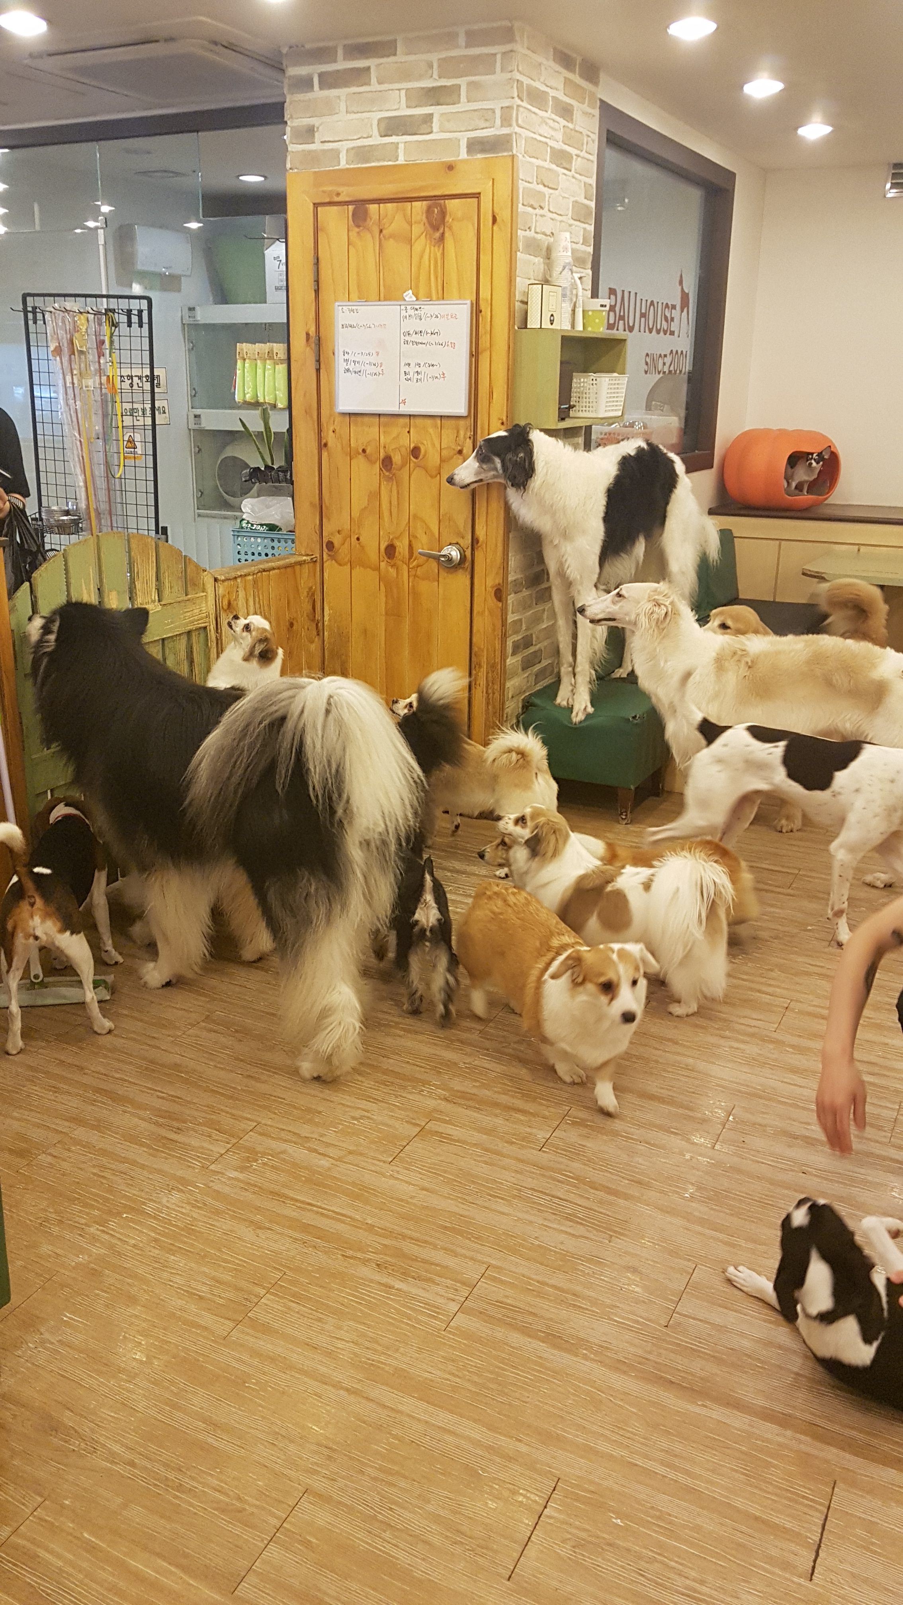
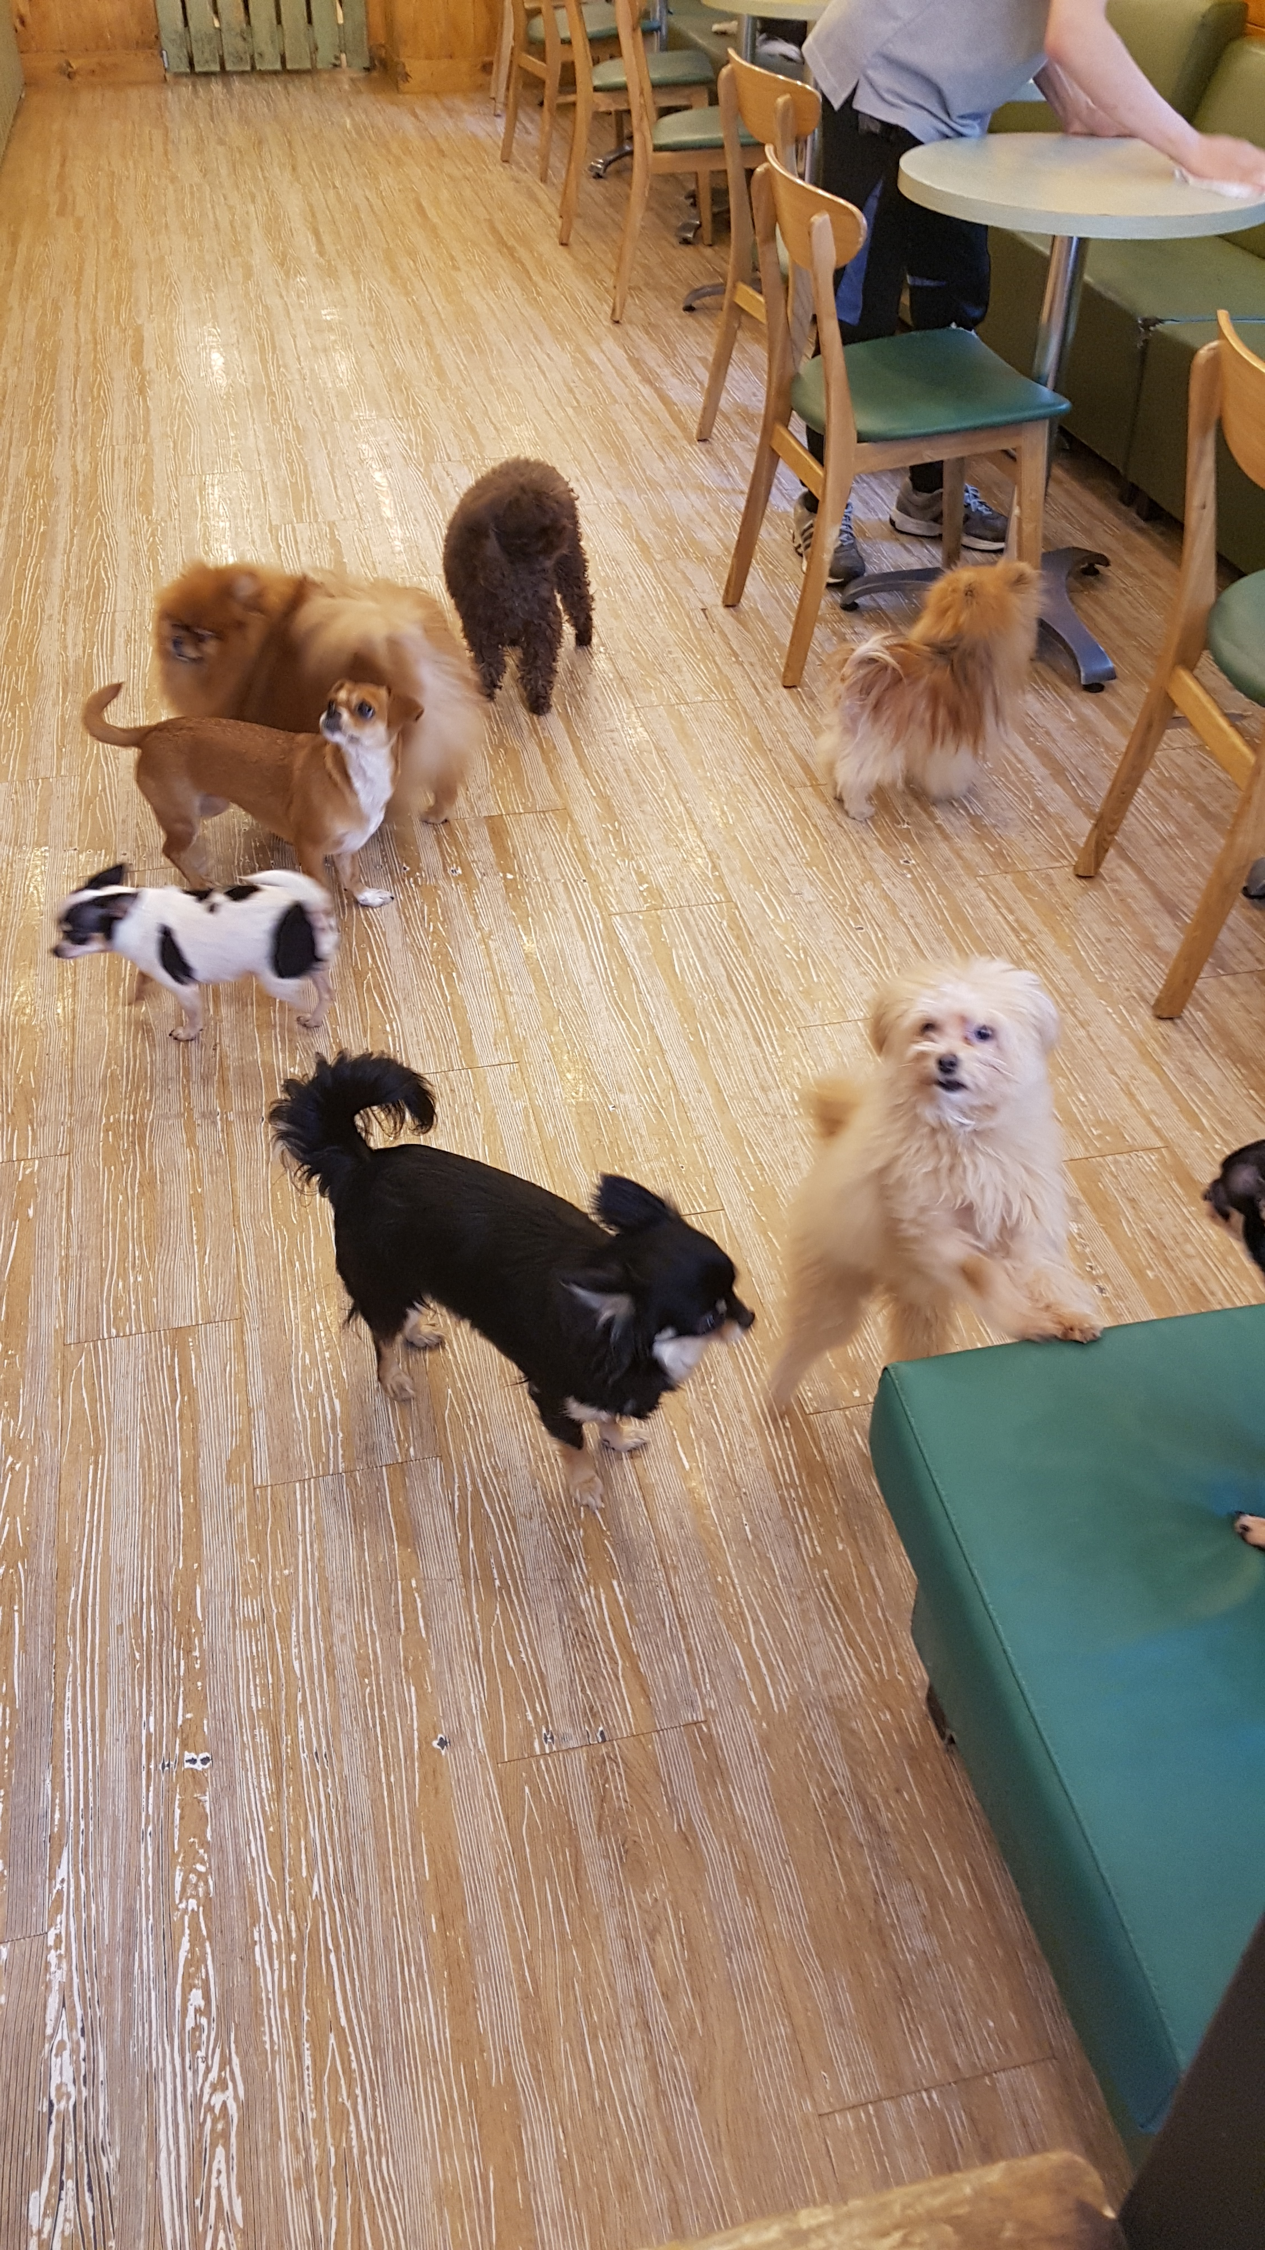
We visited dog cafe to collect some datas
4
Notes:
This is the schedule later.

Slide 21
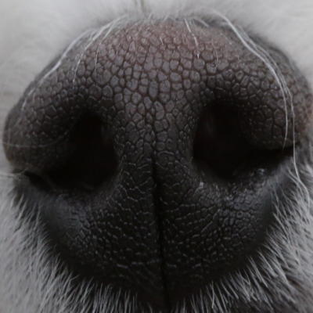
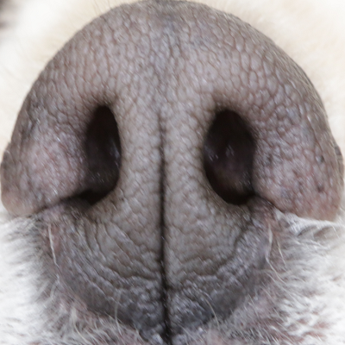
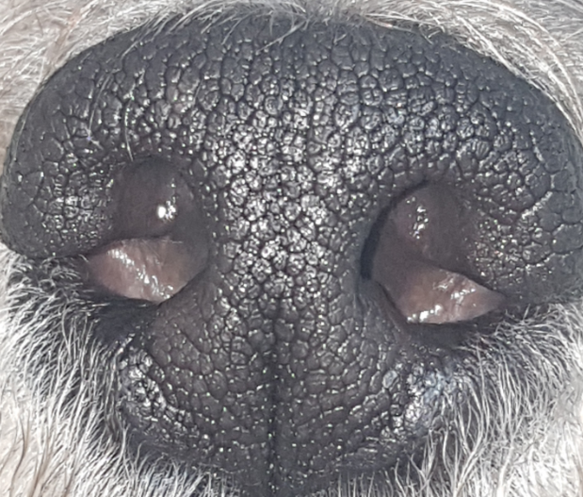
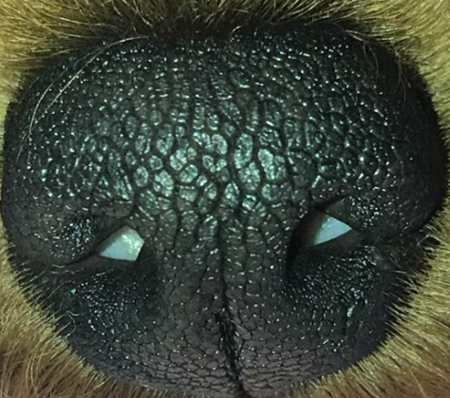
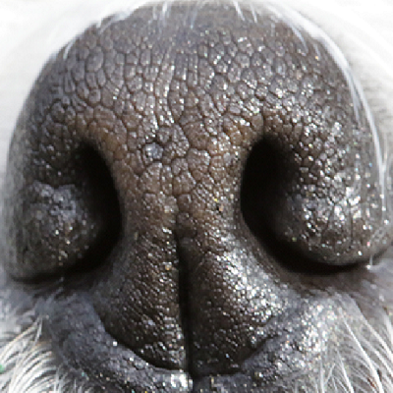
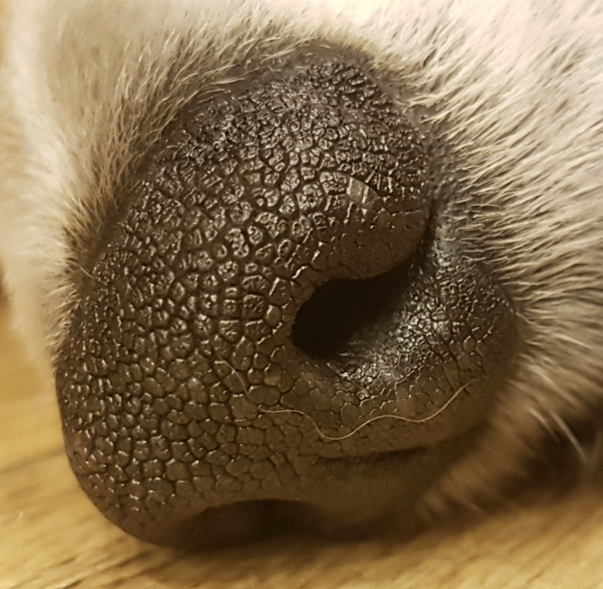
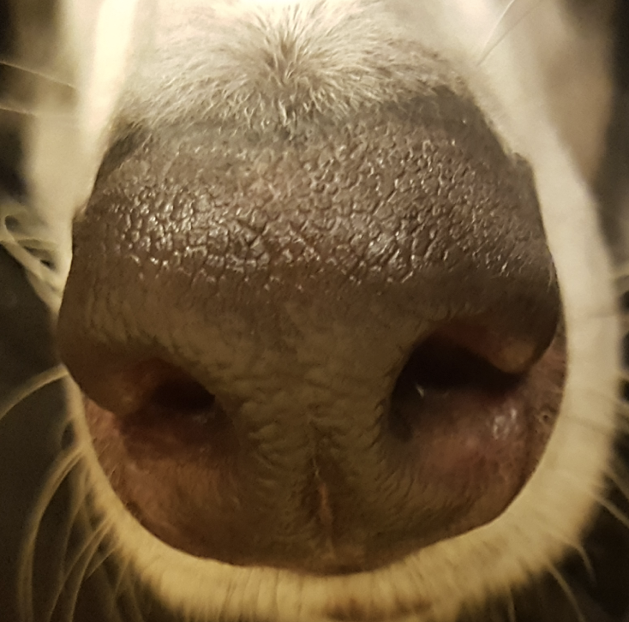
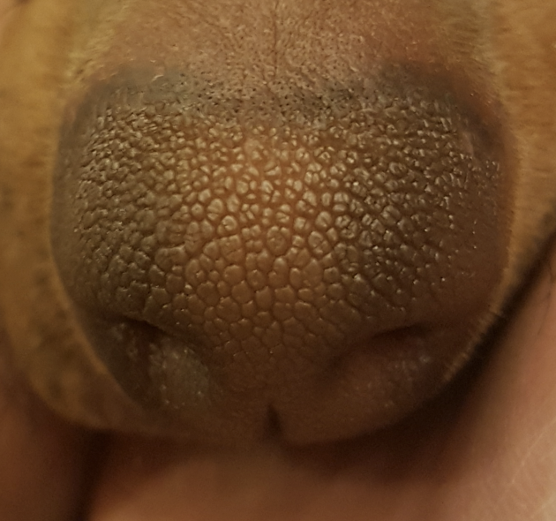
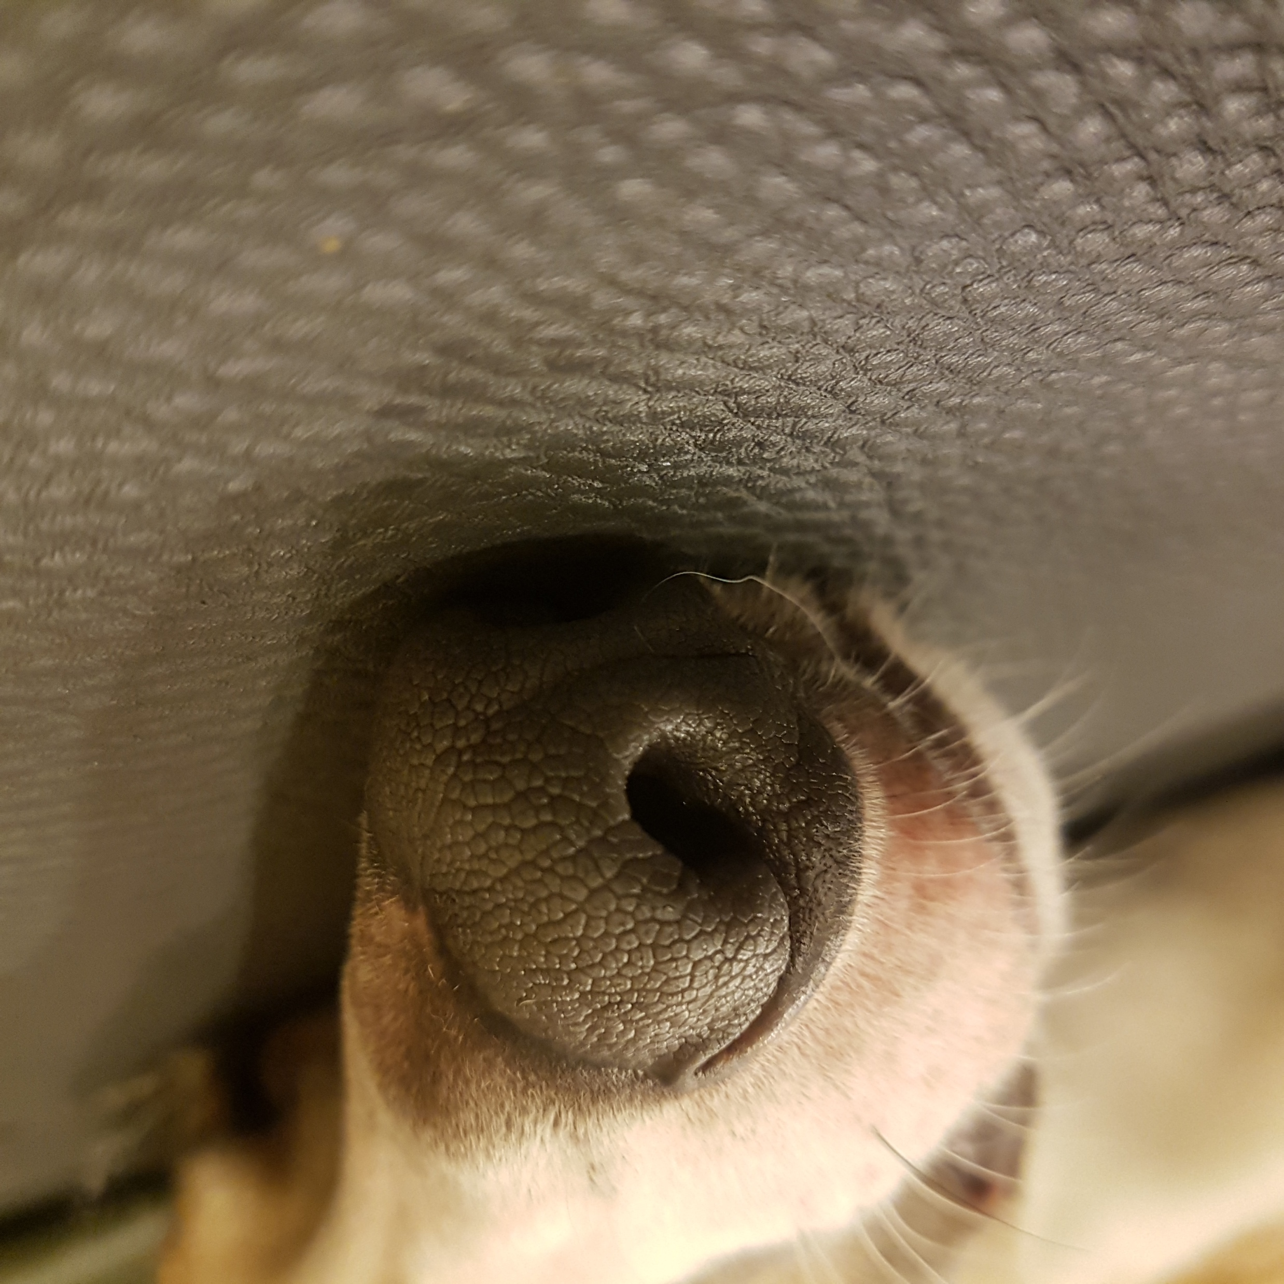
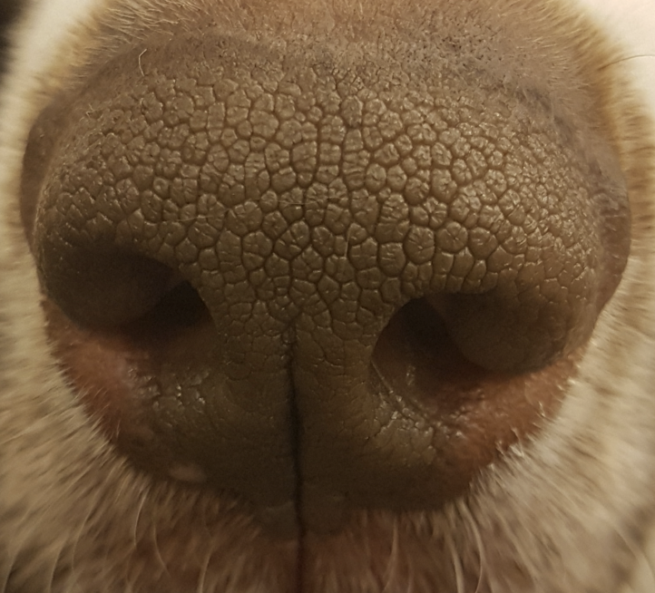
As a result, we collected some datas
10 kinds of dogs, 4~6 nose images per dogs, totally about 50 datas
(which is high resolution)
4
Notes:
This is the schedule later.

Slide 22
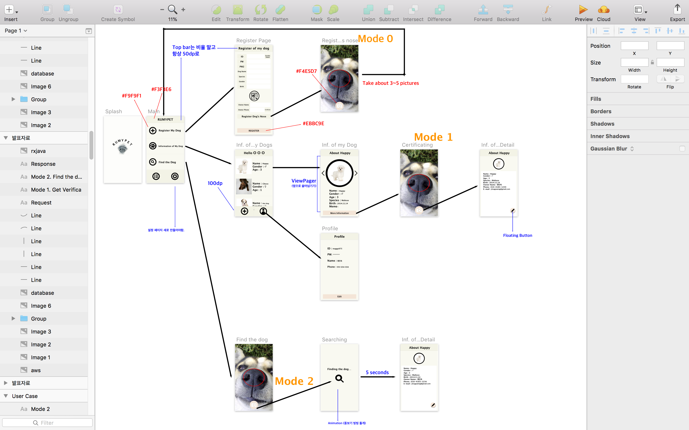

We used ‘Sketch’ for UI Design Tool
Sketch
4
Notes:
This is the schedule later.

Slide 23



Totally we used three programming languages
5

Slide 24




Editor we used in developing
5

Slide 25






Library and Framework we used
5

Slide 26
We Controlled the Version using GitHub
5

Slide 27
4. Execution Result

Slide 28
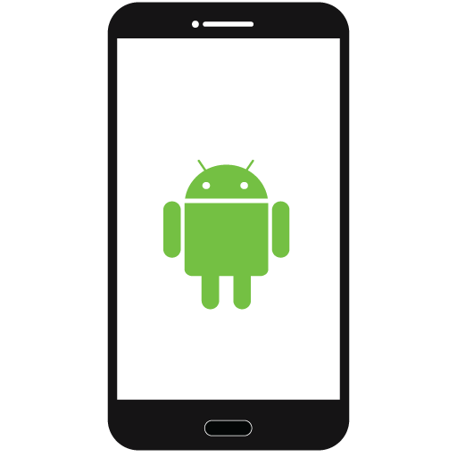

6

Slide 29
5. Execution Explanation

Slide 30
Mode 0
Mode 1
Mode 2
Registering the dog
Verification
Identification
7

Slide 31

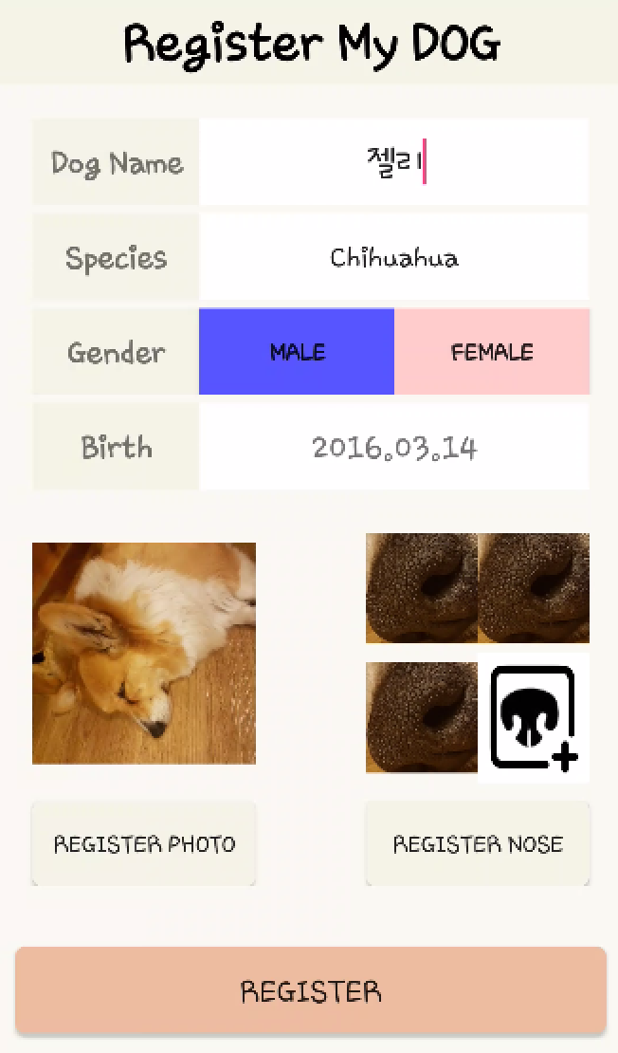

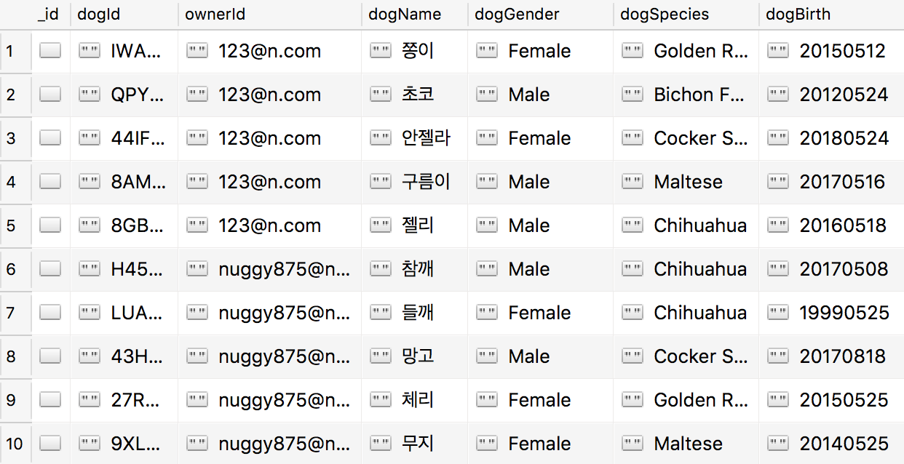
Registering the dog (Mode 0)
“When user register the dog, the informations are saved in MongoDB”
7
Notes:
This is the UI Deisign we did last week.
Using this, Chan il Kim applied this into Android Studio.

Slide 32


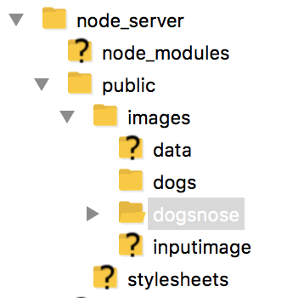
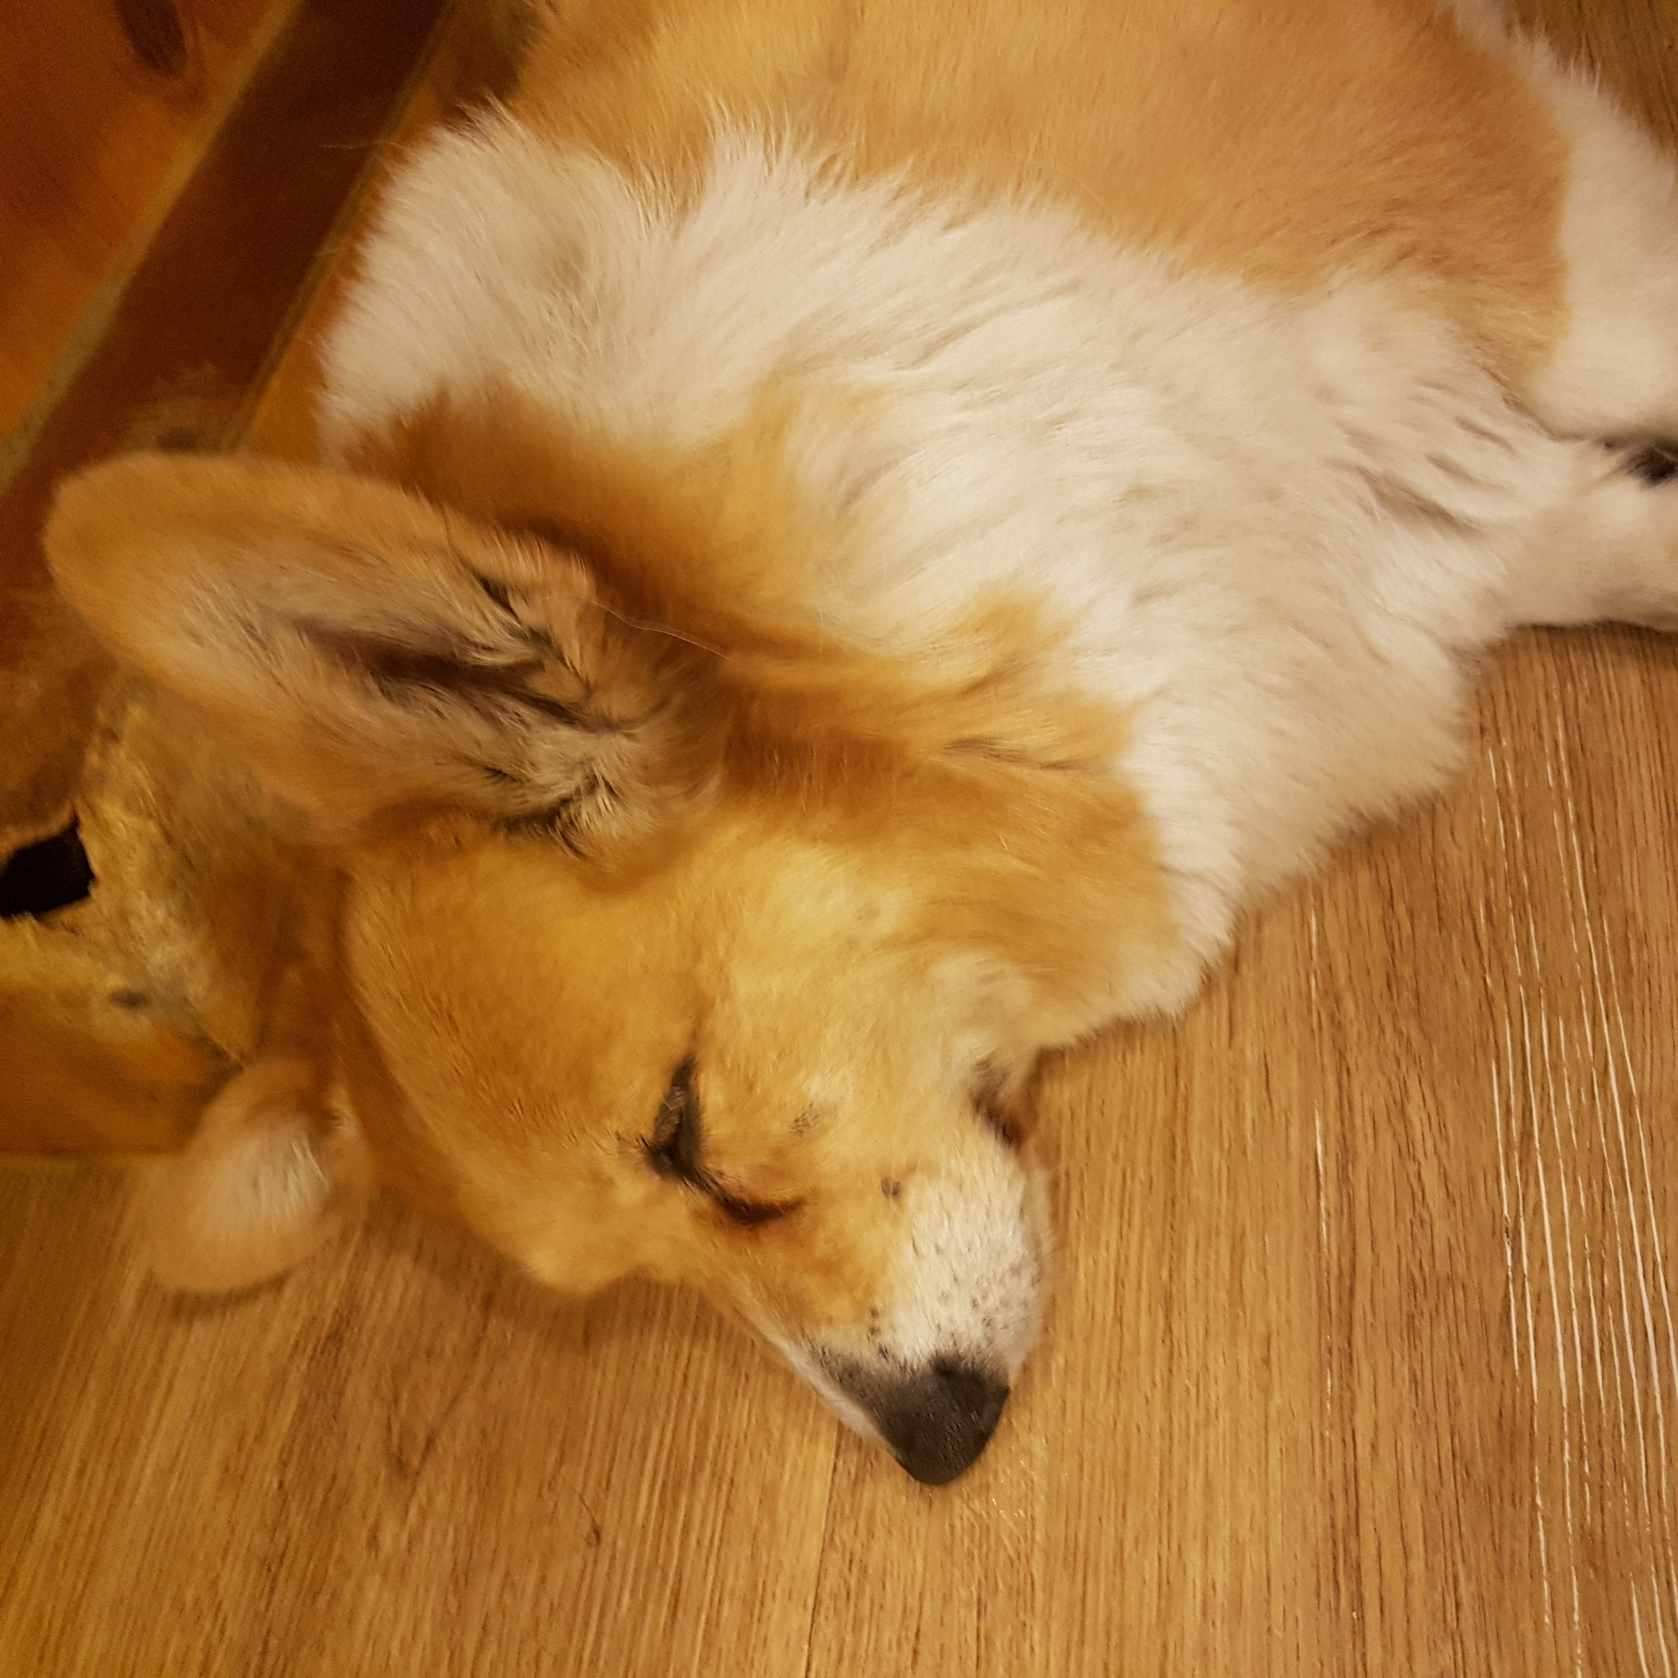
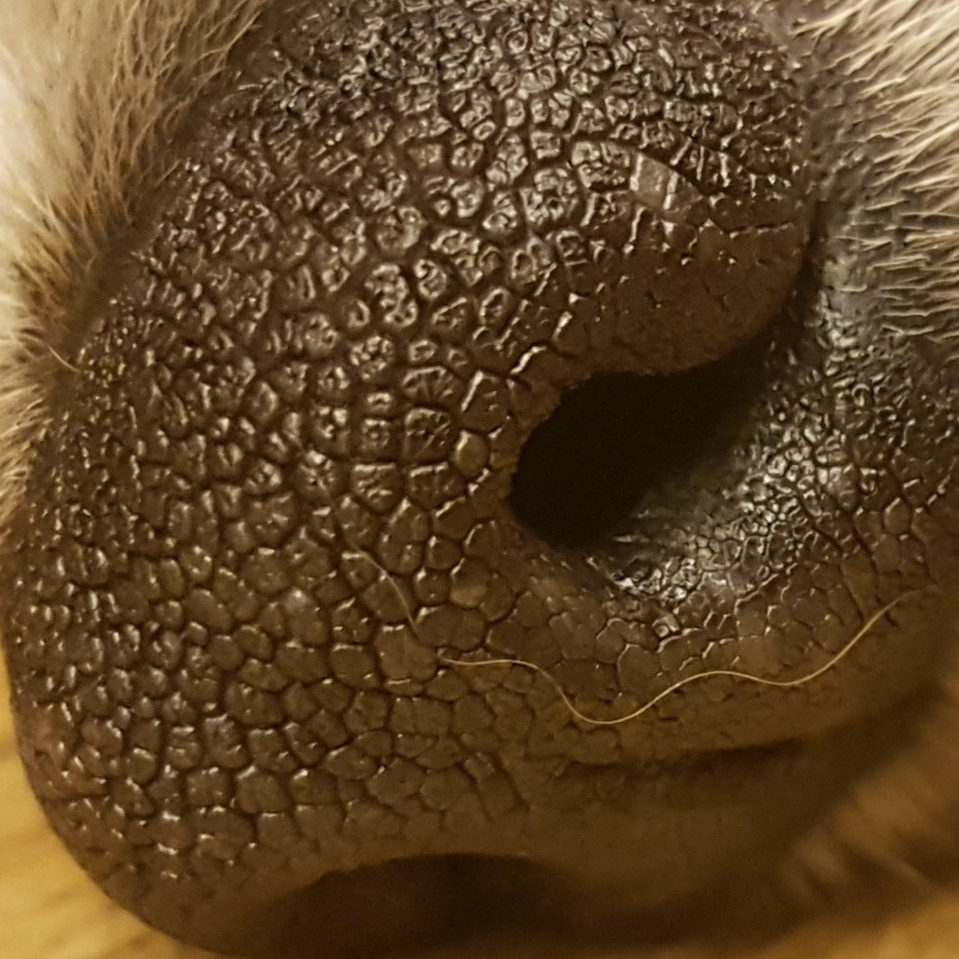
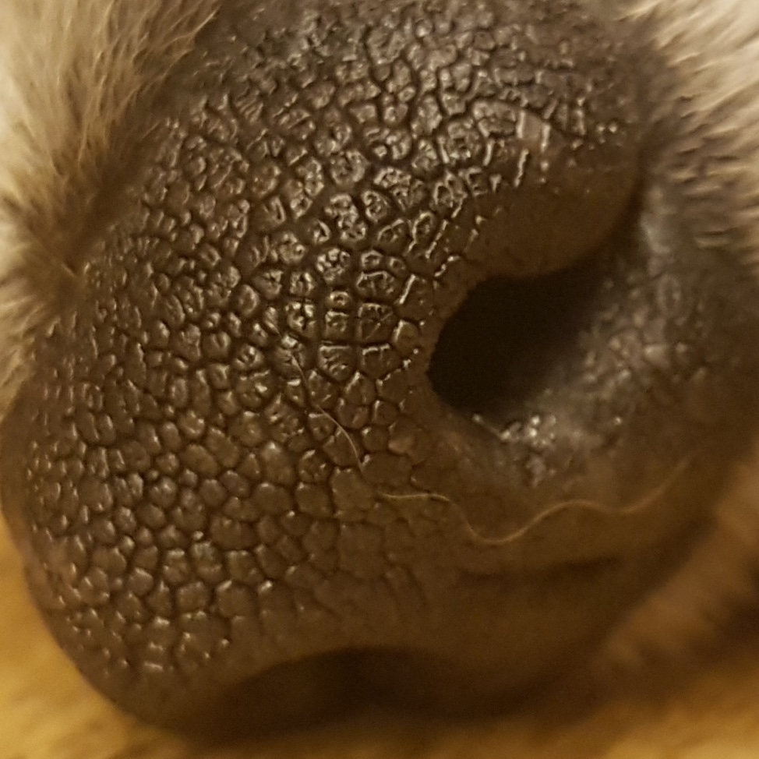
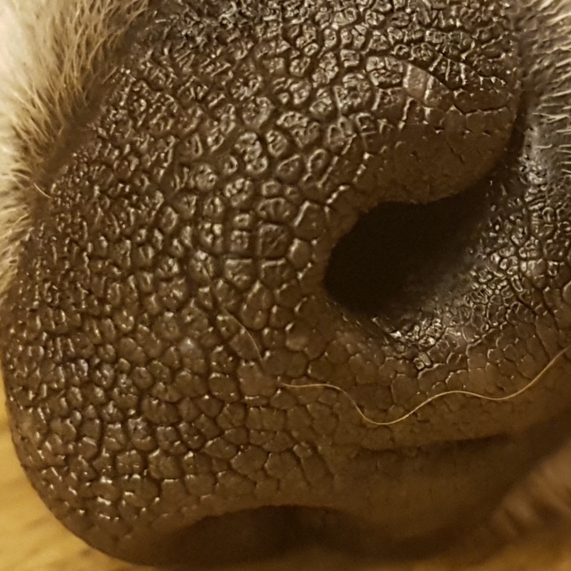
Registering the dog (Mode 0)
“The images are saved in Local Storage of Server by Dog ID (random String)”
8
Notes:
This is the UI Deisign we did last week.
Using this, Chan il Kim applied this into Android Studio.

Slide 33
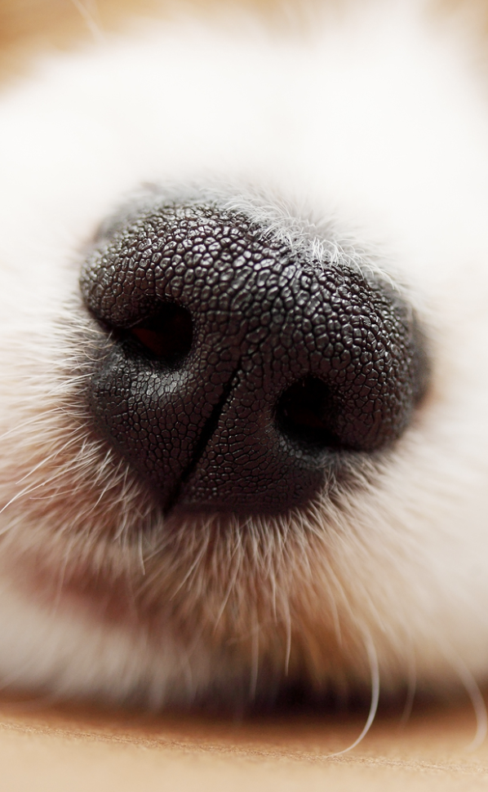

Uploading data using Recording the Video
“Recording for 5 seconds of dog’s nose”
7
Notes:
This is the UI Deisign we did last week.
Using this, Chan il Kim applied this into Android Studio.

Slide 34

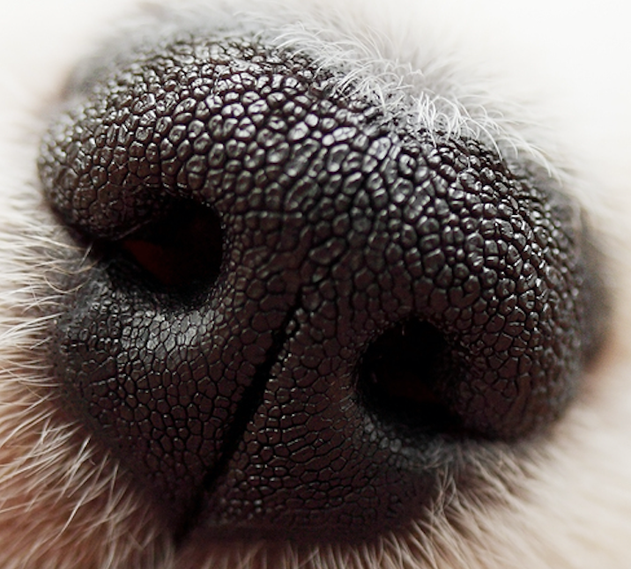
Uploading data using Recording the Video
7
Notes:
This is the UI Deisign we did last week.
Using this, Chan il Kim applied this into Android Studio.

Slide 35
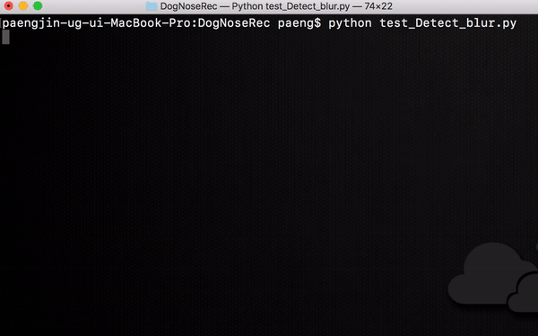
Uploading data using Recording the Video
30 Frames per second
Extract non-blurred image in the Video Using Laplasian Filter in Open CV
We Set the threshold based on 1080p video file.
7
Notes:
This is the UI Deisign we did last week.
Using this, Chan il Kim applied this into Android Studio.

Slide 36
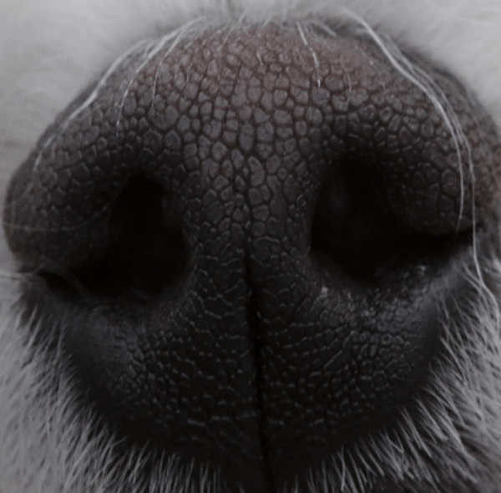
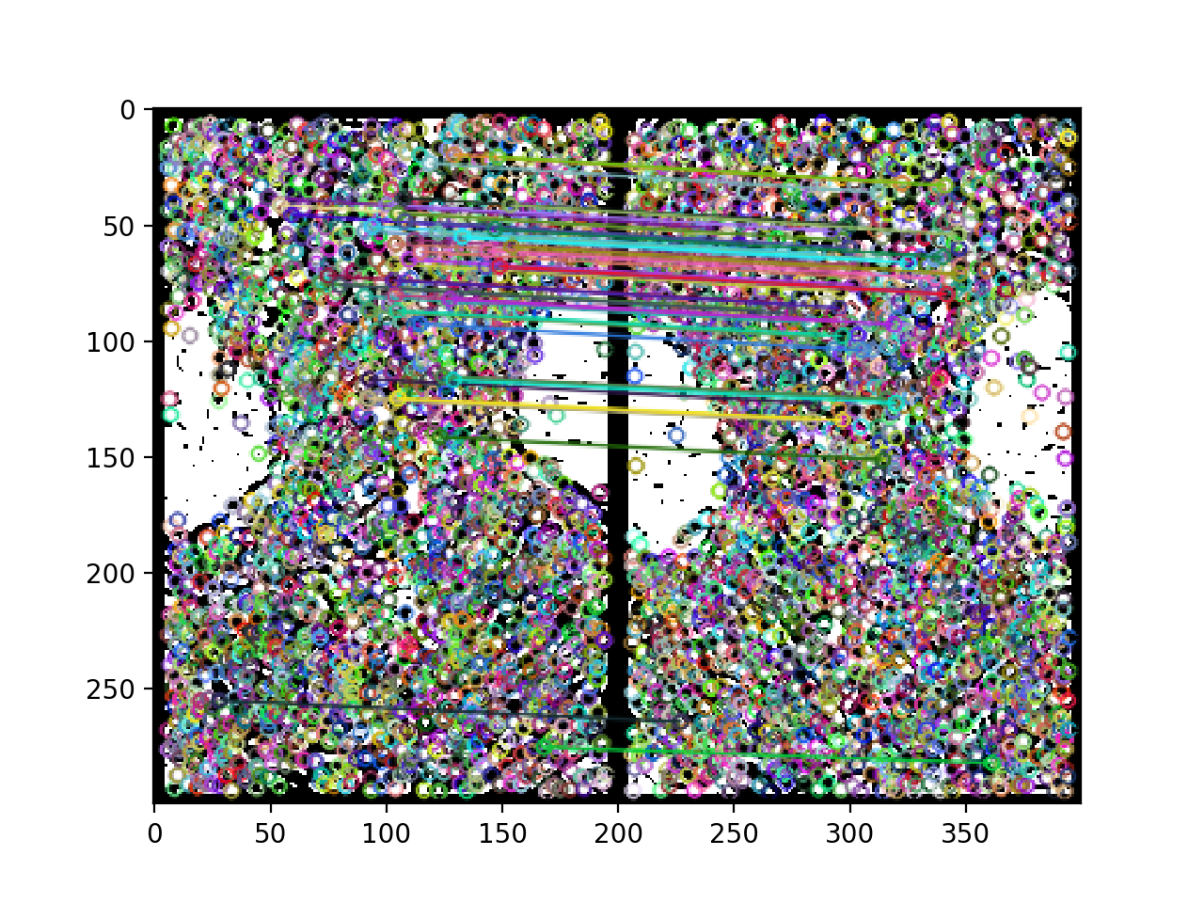
Pre-Processing & Feature Matching
“We used the Preprocessing method that we have developed.
“And we used SIFT Method for Feature matching Method (SIFT)”.
Pre-processing Method
Feature Matching Method
12
(SIFT)
Notes:
This is the UI Deisign we did last week.
Using this, Chan il Kim applied this into Android Studio.

Slide 37

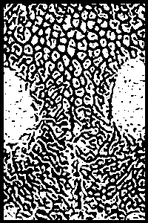
Pre-Processing
“Choose this process through many performance test”
Cropping
Gray Scaling
Equalization
Gabor-Filter
Pre-processing Method
12
Notes:
This is the UI Deisign we did last week.
Using this, Chan il Kim applied this into Android Studio.

Slide 38
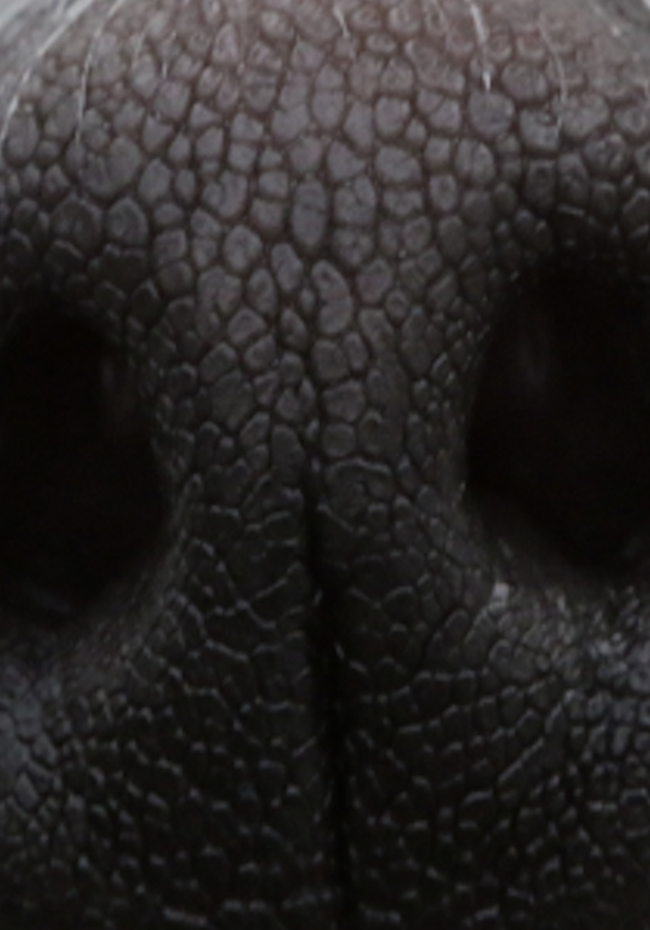
Pre-Processing
“Crop the Core part of the image.”
Cropping
Gray Scaling
Equalization
Gabor-Filter
Pre-processing Method
12
Notes:
This is the UI Deisign we did last week.
Using this, Chan il Kim applied this into Android Studio.

Slide 39
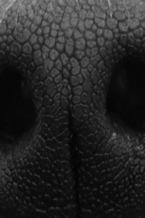
Pre-Processing
“Gray Scaling”
Cropping
Gray Scaling
Equalization
Gabor-Filter
Pre-processing Method
12
Notes:
This is the UI Deisign we did last week.
Using this, Chan il Kim applied this into Android Studio.

Slide 40

Pre-Processing
“Equalize the RGB Value.”
Cropping
Gray Scaling
Equalization
Gabor-Filter
Pre-processing Method
12
Notes:
This is the UI Deisign we did last week.
Using this, Chan il Kim applied this into Android Studio.

Slide 41
Pre-Processing
“And put the Gabor filter on the image”
Cropping
Gray Scaling
Equalization
Gabor-Filter
Pre-processing Method
12
Notes:
This is the UI Deisign we did last week.
Using this, Chan il Kim applied this into Android Studio.

Slide 42


Feature Matching
“Feature Matching using SIFT Method”
Cropping
Gray Scaling
Find Features
Match Features
Equalization
Gabor-Filter
Pre-processing Method
Feature Matching Method
12
Notes:
This is the UI Deisign we did last week.
Using this, Chan il Kim applied this into Android Studio.

Slide 43

Feature Matching
“Feature Matching using SIFT Method”
Find Features
Match Features
Feature Matching Method
12
Notes:
This is the UI Deisign we did last week.
Using this, Chan il Kim applied this into Android Studio.

Slide 44

MODE1(Verification) & MODE2 (Identification)
“We Divided router for MODE 1(Verification) and MODE 2(Identification)”
9
Notes:
This is the UI Deisign we did last week.
Using this, Chan il Kim applied this into Android Studio.

Slide 45


MODE 1 (Verification)
“MODE 1 needs verification to get your dog’s private information”
Taking picture
“True” or ”False”
10
Notes:
This is the UI Deisign we did last week.
Using this, Chan il Kim applied this into Android Studio.

Slide 46

Schedule & Progress – Python (in mode 1)
“In Python for MODE 1, if the average of the result is over than 50,
it returns ‘True’, and if below, it returns ‘False’ ”
Input Image
“50 is based on many performance test”
11
Database
Notes:
This is the UI Deisign we did last week.
Using this, Chan il Kim applied this into Android Studio.

Slide 47

Schedule & Progress – Android (in mode 1)
“If TRUE, it will show you the dog’s private information in detail”
“True”
13
Notes:
This is the UI Deisign we did last week.
Using this, Chan il Kim applied this into Android Studio.

Slide 48
Schedule & Progress – Android (in mode 1)
“If FALSE, it will show you Nothing”
“False”
“Verification Failed”
14
Notes:
This is the UI Deisign we did last week.
Using this, Chan il Kim applied this into Android Studio.

Slide 49

Schedule & Progress – Android (in mode 2)
“In our simple main page, you can get into the find the dog mode”
15
Notes:
This is the UI Deisign we did last week.
Using this, Chan il Kim applied this into Android Studio.

Slide 50

Schedule & Progress – Server (in mode 2)
“For MODE 2, we made a router of /identification”
Taking 3 pictures
”It is dog C”
16
Notes:
This is the UI Deisign we did last week.
Using this, Chan il Kim applied this into Android Studio.

Slide 51

Schedule & Progress – Android (in mode 2)
“We made a candidate through the result score of the matching algorithm”
“You can click one of the list view to check the owner’s information”
18

Slide 52

Schedule & Progress – Python (in mode 2)
“In Python for MODE 2, the function returns string data in order of the matching score”
Input Image
19
Database
Notes:
This is the UI Deisign we did last week.
Using this, Chan il Kim applied this into Android Studio.

Slide 53
2. PROBLEMS & SOLUTION

Slide 54


PROBLEMS & SOLUTIONS
Problem 1
Still, the process time is the problem... We don’t have that much data of the dog now in the database, but when it becomes commercialized, It should have some solutions.
Solution 1
Classification of the dog datas can help in some extent.
After, we should classify the dog datas
by species, colors or something else.
It could save much more time.
21
Notes:
--ppt reading--
Now, we have our own server!

Slide 55



PROBLEMS & SOLUTIONS
Problem 2
We need more and more database for accuracy in testing
for pre-processing and feature matching algorithm.
But we have difficulty in collecting data...
Because the data should be a high resolution image.
It is rare...
Solution 2
To commercialize this project, we maybe should take some supports from the enterprise..
22
Notes:
--ppt reading--
Now, we have our own server!

Slide 56
3. PLANS

Slide 57
PLANS for next week
Week 14 | Final Demonstration
Notes:
ppt reading

Slide 58


Q&A

Slide 59
Thank you!

